Slide 1
Internet Peering
Dean Belev (VP Services)

Slide 2
What is Internet Peering ?
“…peering is a voluntary interconnection of administratively separate Internet networks for the purpose of exchanging traffic between the "down-stream" users of each network.” Source: WIkipedia
Peering Options/Sources
Transit customers (customers)
Peering partners (peers)
Internet Exchange Points (IXPs)
How to measure the Peering
Peering traffic vs Transit ratio
Cost savings from Transit
as-path-length (“…the average number of steps along the shortest paths for all possible pairs of network nodes.” Source: WIkipedia)
Peers (Quantity & Quality)
02.
NETIX.NET

Slide 3
BENEFITS OF PEERING
Cost savings:
Peering allows networks to exchange traffic without having to pay for it, which can be a cost-effective alternative to using IP Transit services.
Improved customer experience:
Peering can improve the customer experience by reducing network congestion and improving network performance, resulting in faster and more reliable access to online services and applications.
Improved network performance:
Peering can result in lower latency and improved network performance, as traffic between the two networks can be exchanged directly, rather than having to pass through multiple intermediaries.
Increased network control:
Peering allows networks to have more control over how their traffic is routed and delivered, which can be beneficial for networks with specific requirements or preferences for how their traffic is handled.
Increased network resilience:
Peering can improve network resilience by providing multiple paths for traffic to travel between the two networks. If one path fails, traffic can automatically be routed via another path.
03.
NETIX.NET

Slide 4
Peering Ranking
# customers
# peers
# IXPs
Sources
RIPE NCC – RIPE stat
as-path-length (22 collectors)
CAIDA – AS Rank
# customers/ASN
#peers/ASN
Hurricane Electric – BGP Peer Report
TOP 1000/100/20 – most well connected ASNs
IXPs/ASN
03.
NETIX.NET

Slide 5
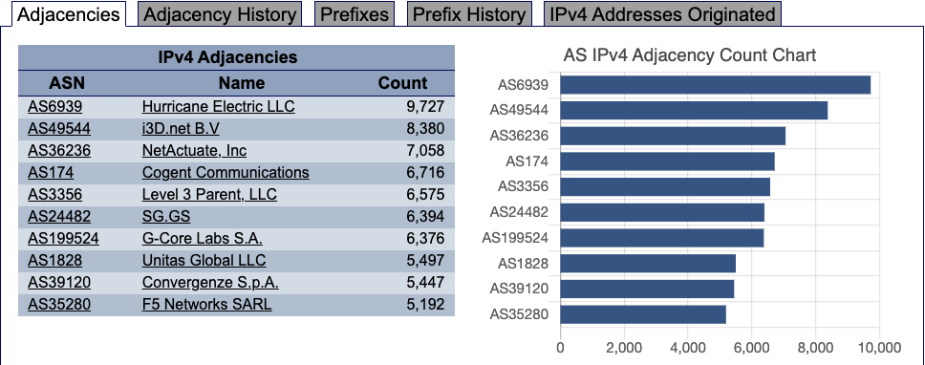
Top 1000
Source: Hurricane Electric – BGP Peer Report
Top 10
RIPE NCC – RIS collectors
Route-views project
Others…
03.
NETIX.NET

Slide 6
Top 1000 Ranking
Source: NetIX internal tool
03.
NETIX.NET

Slide 7
Peering Ranking
# customers
# peers
# IXPs
How to measure the Peering
Peering traffic vs Transit ratio
Cost savings from Transit
as-path-length (“…the average number of steps along the shortest paths for all possible pairs of network nodes.” Source: WIkipedia)
Peers (Quantity & Quality)
03.
NETIX.NET

Slide 8
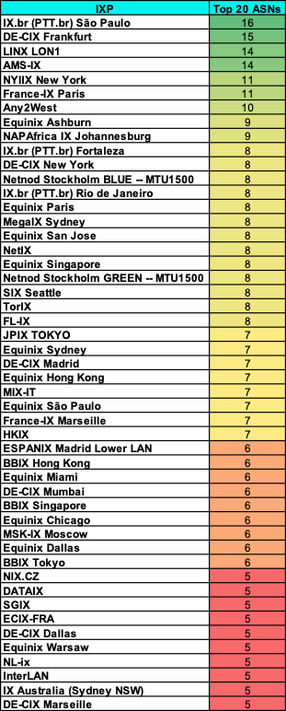
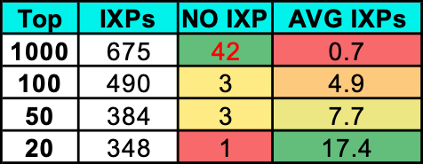
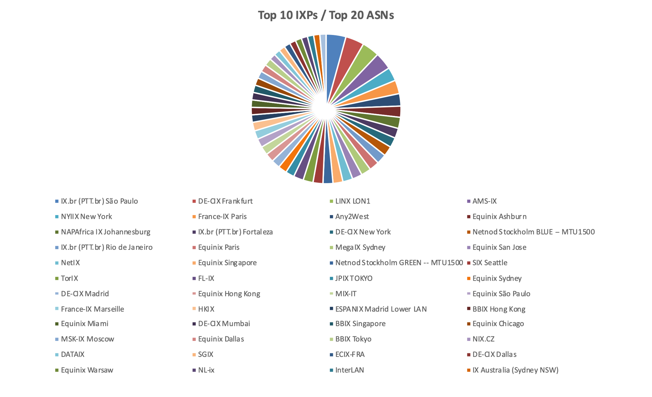
IXP Peering
03.
Source: Hurricane Electric – BGP Peer Report
NETIX.NET

Slide 9
IXP Peering
many customers
many peers
No need of IXPs
customers
peers
Many IXPs
03.
Source: Hurricane Electric – BGP Peer Report
NETIX.NET

Slide 10
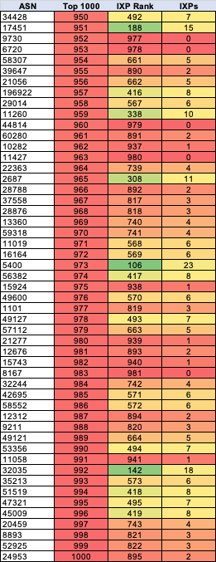
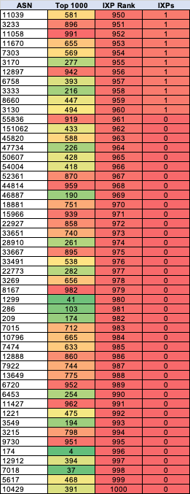
IXP Peering
customers
peers
Many IXPs
many customers
many peers
No need of IXPs
03.
Source: Hurricane Electric – BGP Peer Report
NETIX.NET

Slide 11
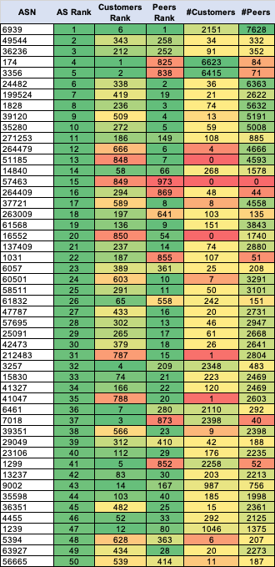
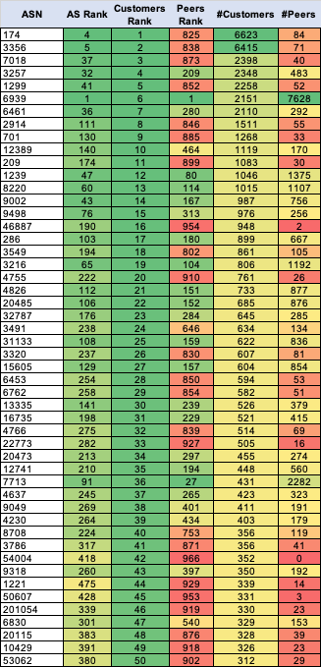
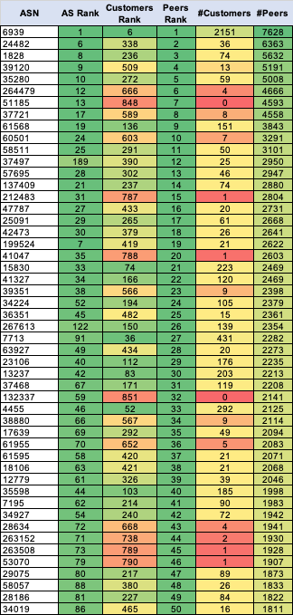
Customers / Peers
03.
Source: CAIDA – AS Rank
NETIX.NET

Slide 12
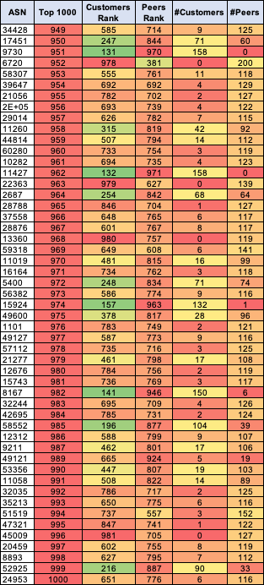
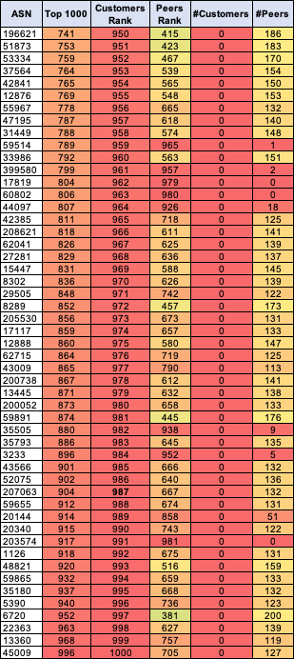
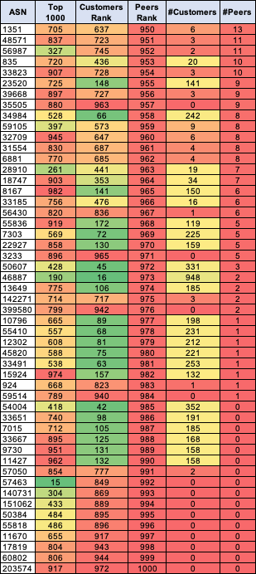
Customers / Peers
An IXP, connected to other IXPs (29)
03.
Source: CAIDA – AS Rank
NETIX.NET

Slide 13
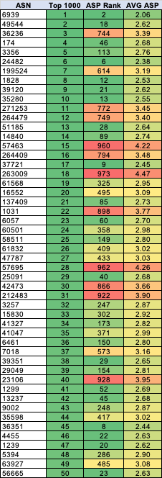
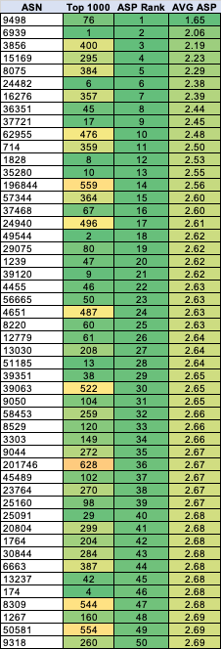
AS-PATH-LENGTH
Big number of adjacencies, but NOT connected to the right peers/customers/IXPs
Small number of adjacencies, but connected to the right peers/customers/IXPs
03.
Source: RIPE NCC – RIPE stat
NETIX.NET

Slide 14
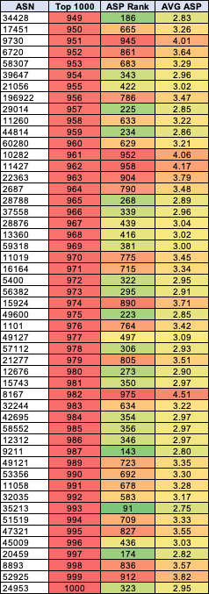
AS-PATH-LENGTH
Small number of adjacencies, but connected to the right peers/customers/IXPs
Big number of adjacencies, but NOT connected to the right peers/customers/IXPs
03.
Source: RIPE NCC – RIPE stat
NETIX.NET

Slide 15
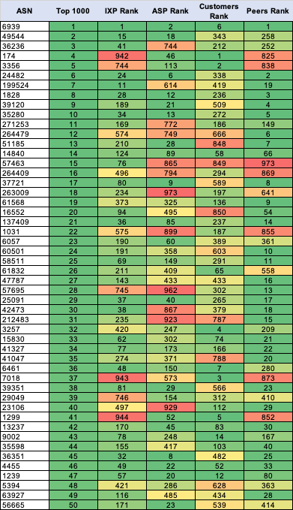
Summary
Your AS Rank will improve the more you peer !
03.
Source: RIPE NCC – RIPE stat
Source: CAIDA – AS Rank
Source: Hurricane Electric – BGP Peer Report
NETIX.NET

Slide 16
CONTACT
Email me:
dbelev@netix.net
Email our expert team:
contact@netix.net
Get involved on social media:
@NetIX
@netix_dotnet
@NetIXnet
@netix_dotnet
@NetIXdotnet

